Slide 1
Global Population Patterns and Growth Trends (1970–2022)

Slide 2
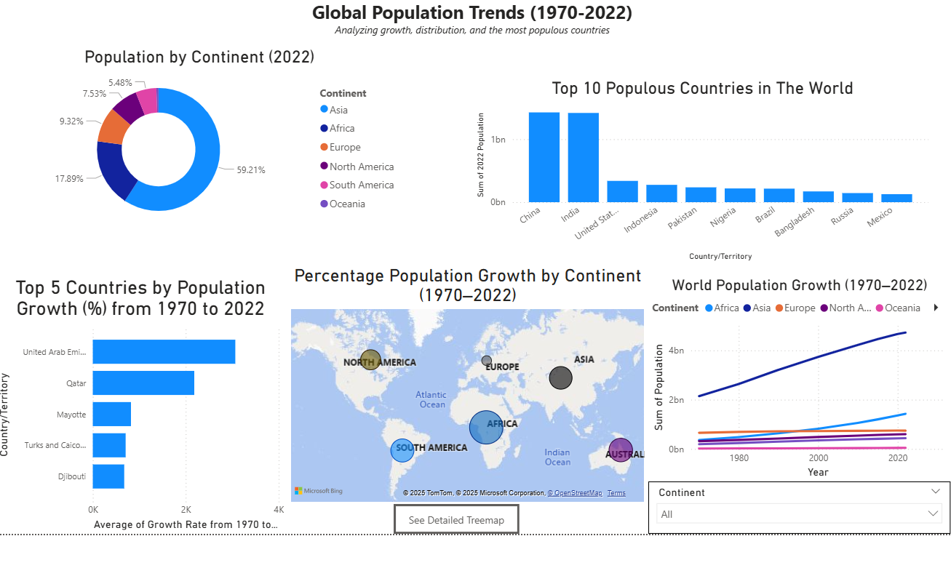
Purpose: To explore population growth, distribution, and the most populous countries from 1970 to 2022

Slide 3
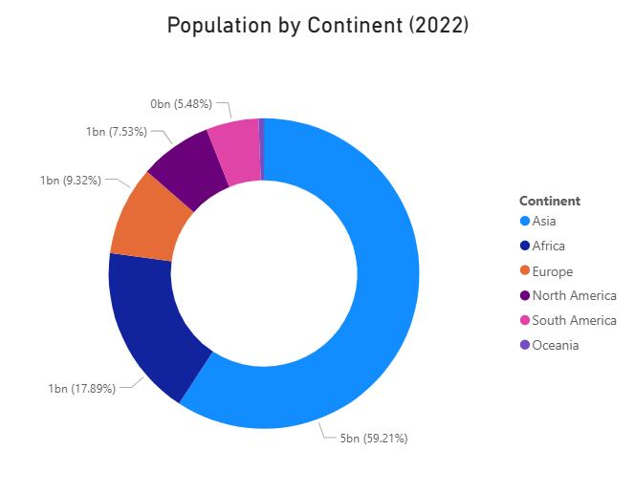

Slide 4
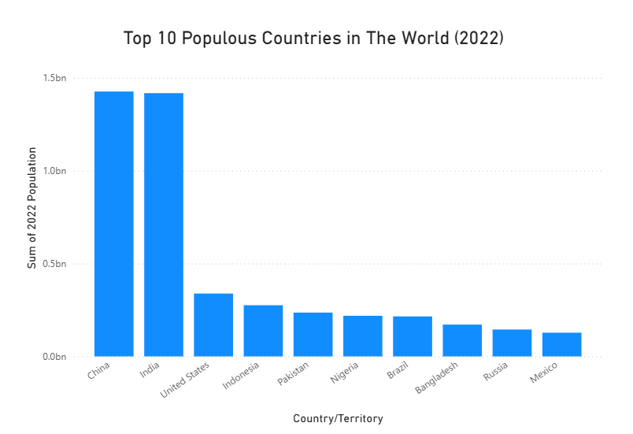

Slide 5
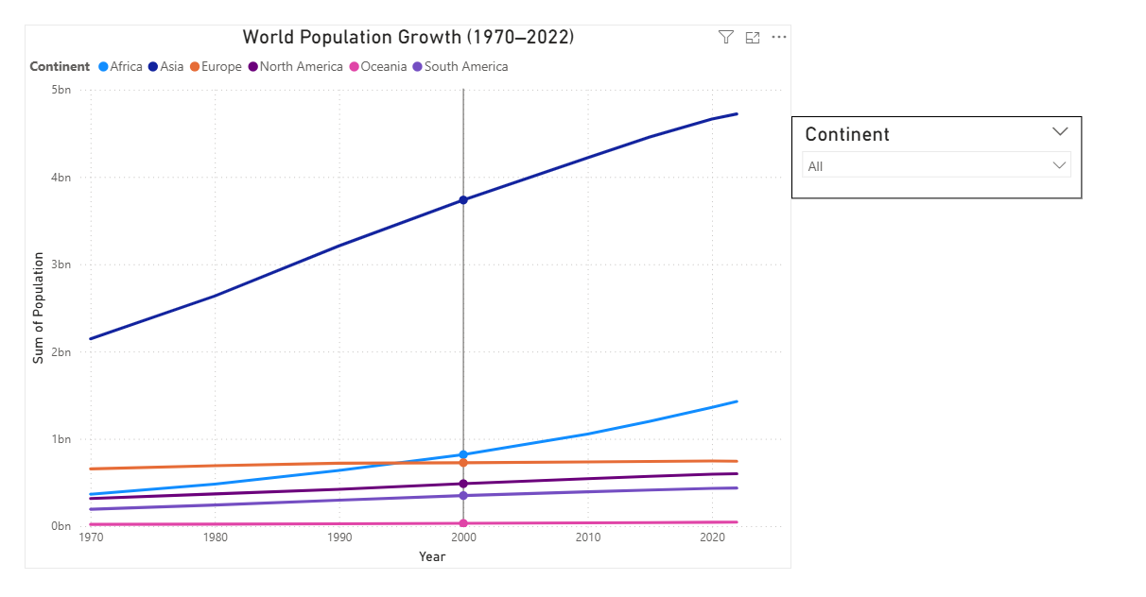

Slide 6
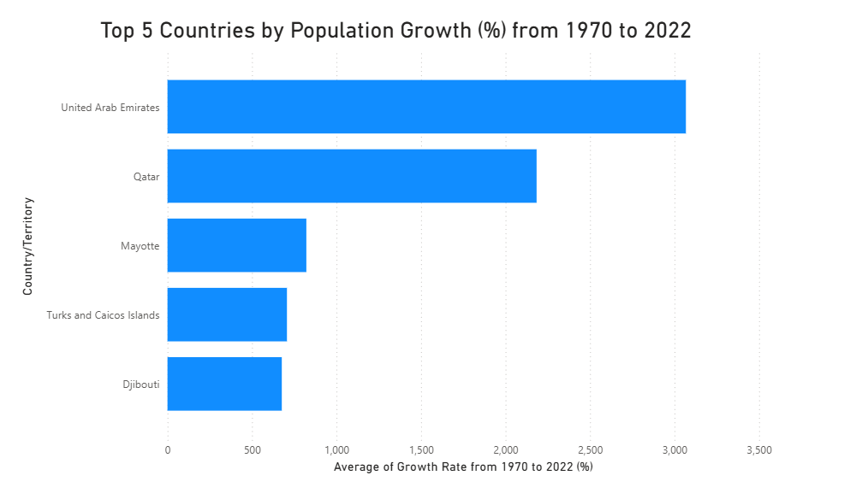

Slide 7
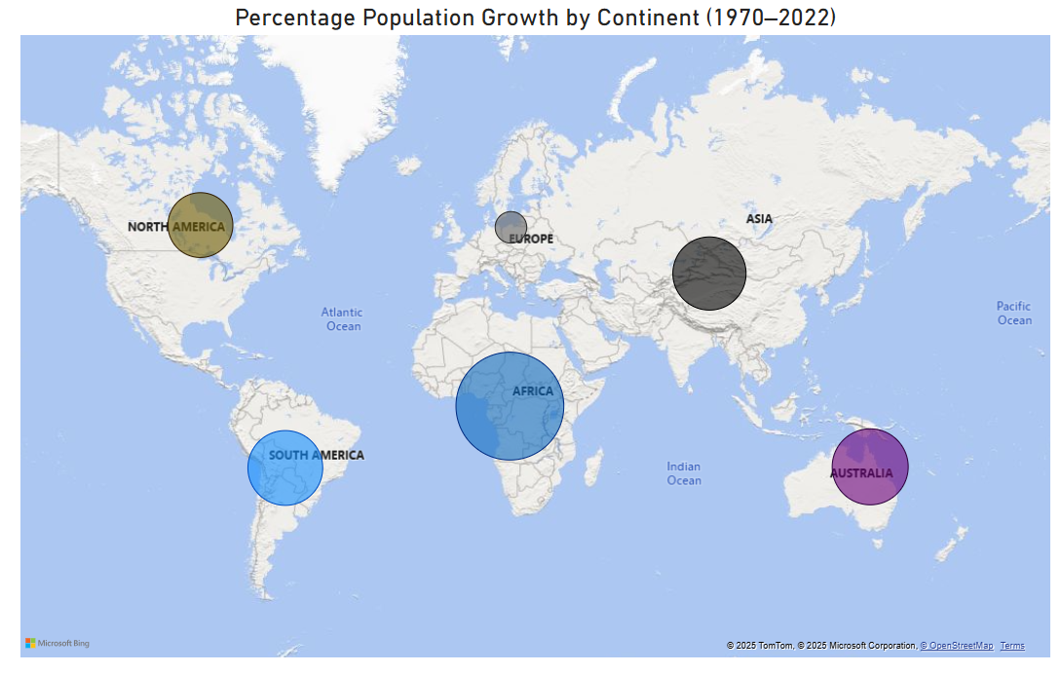

Slide 8
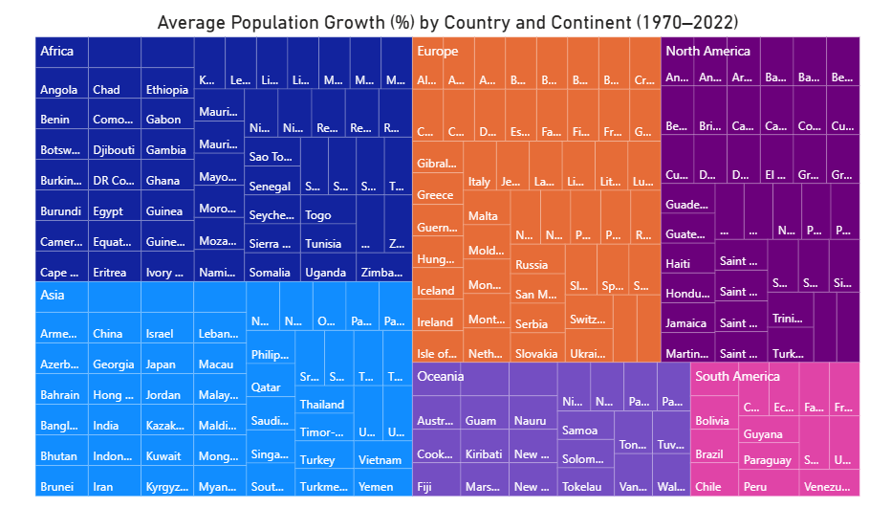

Slide 9
Insights
Insight 1 – Asia’s Population Dominance In 2022, Asia accounted for nearly 60% of the global population, making it the most populous continent. This is reflected in the fact that China and India are the two largest countries by population worldwide.
Insight 2 – Africa’s Accelerated Growth Although Africa has a smaller total population compared to Asia, its growth trend since 1970 has been significantly steeper, highlighting its rapid demographic expansion over the past five decades.
Insight 3 – Exceptional Country-Level Growth Between 1970 and 2022, countries like the United Arab Emirates and Qatar recorded extraordinary population increases of over 2,000%, driven mainly by economic development and high migration rates.

